Slide 2
Session 1 Objectives – Workshop Welcome
By the end of this session, you will be able to⎯
Explain the objectives of this workshop
Express expectations and relate them to the objectives of the workshop
Decide on and agree to group norms for the workshop
Find and refer to the workshop schedule
Find and refer to the HRCD for PHSCM assessment guide and the data collection tool

Slide 3
Activity – Introductions!
Draw a number from the basket
Find the person who has your same number
Share your⎯
Name
Designation
Station
1 thing that interests you about human resource management
1 expectation for this workshop
Introduce your partner to the group

Slide 4
Workshop Objectives
By the end of this session, you will be able to⎯
Explain the objectives of this workshop
Explain the context and rationale for the assessment
Demonstrate mastery of the data collection tools, collection processes, and dashboard
Demonstrate mastery of analyzing data and developing recommendations and an implementation plan for recommendations
Demonstrate ability to give and receive constructive feedback and the ability to work as a member of an assessment team

Slide 5
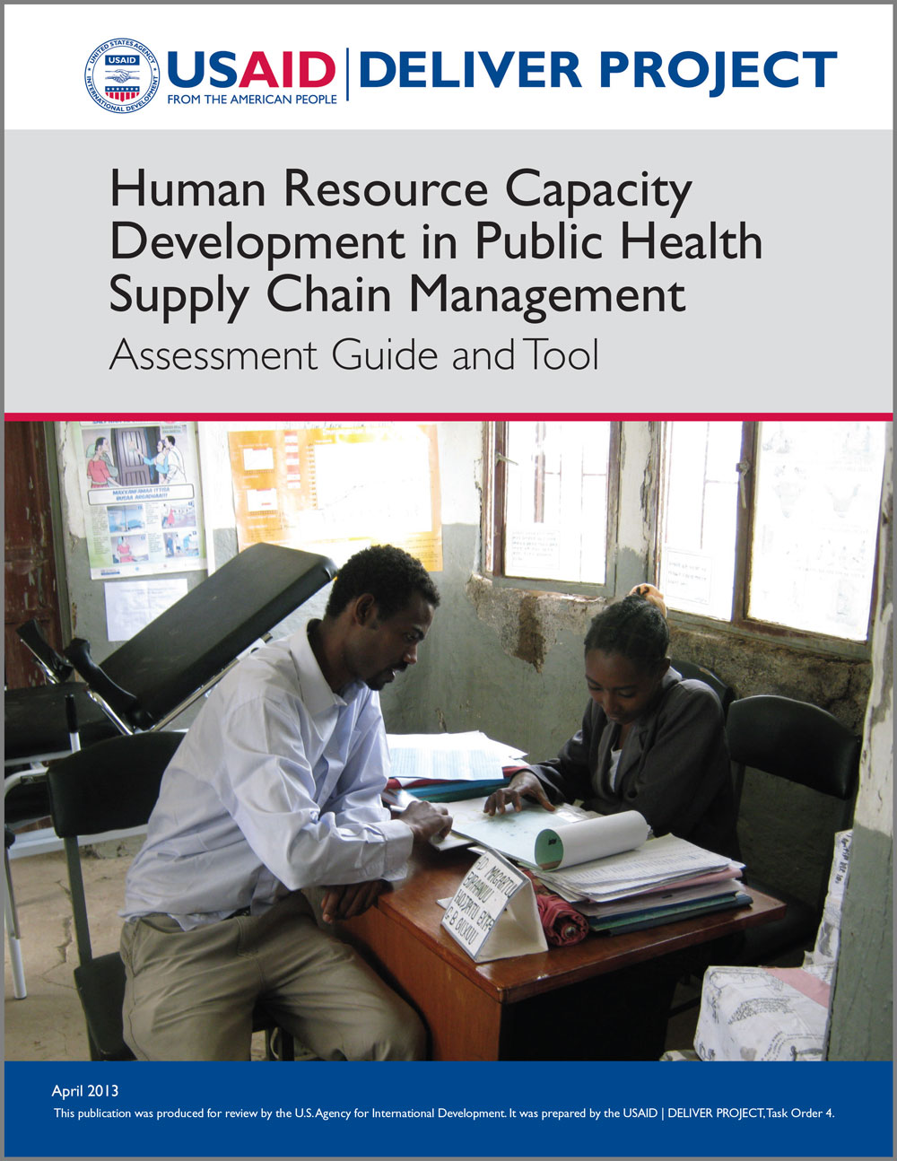
Use the Assessment Guide in this Workshop

Slide 6
Workshop Schedule
Day 1
8.30 – 9
9 – 9.45
9.45 – 10.30
Registration
Session 1: Workshop Welcome
Session 2: Assessment Introduction and Overview
10.30 – 10.45
Break
10.45 – 12
Session 3: Assessment Process
12 – 1
Lunch
1 – 2.15
2.15 – 3.15
Session 4: Data Collection Tool
Session 5: Data Collection Tool Development
3.15 – 3.30
Break
3.30 – 4.30
4.30 – 4.45
Session 6: Data Collection Tool Development, Continued
End of Day Wrap Up

Slide 7
Workshop Schedule, continued
Day 2
8.30 – 9
9 – 10.30
Introduction to the Day
Session 7: Data Collection Practice
10.30 – 10.45
Break
10.45 – 12
Session 8: Data Collection Practice, continued
12 – 1
Lunch
1 – 3
3 – 3.15
Session 8: Data Analysis and Reporting
Workshop Wrap Up

Slide 8
Session 2 Objectives – Assessment Overview
By the end of this session, you will be able to⎯
Understand and explain the relationship between human resources and supply chain management
Name the five building blocks of human resource capacity and how they relate to building a productive workforce for supply chain management
Understand the purpose of the assessment guide and tool

Slide 9
Six Rights of Supply Chain Human Resources
An effective supply chain involves
engaging the right people…
in the right quantities…
with the right skills…
in the right place…
paid the right salary…
at the right time
…to implement the procedures that direct supply chain operations and ensure the supply of
health commodities

Slide 10
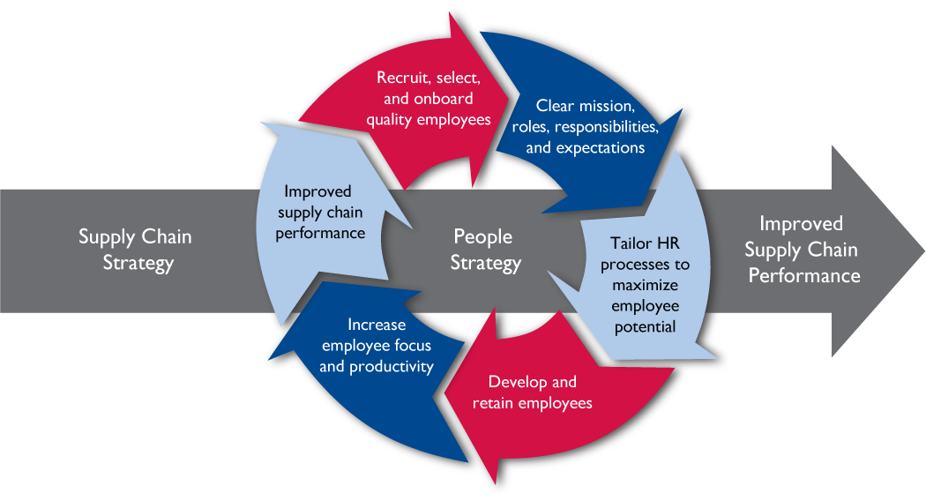
Impact of Human Resources on Supply Chain Performance
Organization and Staffing
Logistics Mangement Information System
Product Selection
Procurement
Inventory Control Procedures
Warehousing and Storage
Forecasting
Organizational Support
Transport and Distribution
Product Use
Finance/Donor Coordination/
CS Planning

Slide 11
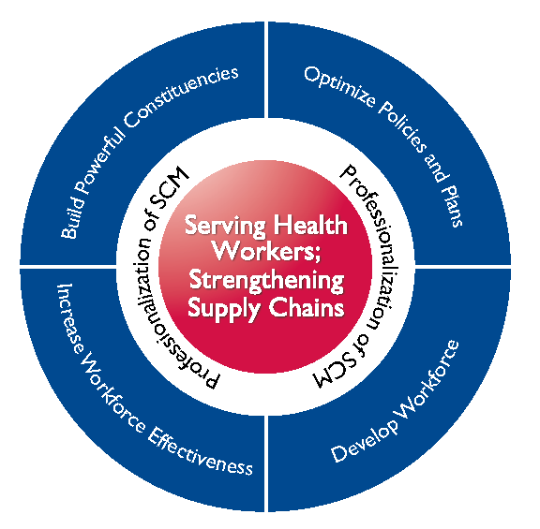
Human Resource Building Blocks that Expand Supply Chain Performance
By nurturing the 5 human resource for health building blocks, supply chain personnel are sourced, developed, and professionalized to support sustained supply chain performance
1
2
5
4
3

Slide 12
Purpose of the Assessment
Document the capacity of a country’s
public health supply chain human resource management
Identify where and how to improve supply chain
performance through the effective human resource management
of supply chain personnel
Document professionalization efforts of personnel working
across a country’s public health supply chains

Slide 13
Session 3 Objectives – Assessment Process
By the end of this session, you will be able to⎯
Describe the process and timelines for the assessment

Slide 14
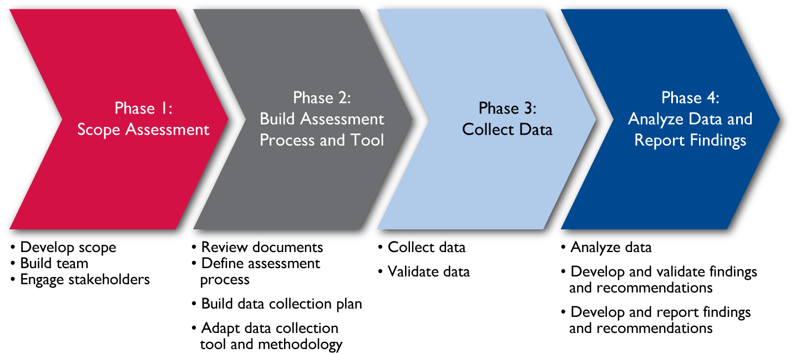
Assessment Process

Slide 15
Assessment Timeline
Week 1
Week 2
Week 3
Week 4
Week 5
Day 1
Day 2
Day 3
Day 4
Day 5
Schedule team planning meetings
Schedule client meetings
Schedule stakeholder workshop
Scope assessment
Confirm data collection schedule
Confirm scope with client
Prepare data collection tool
Conduct stakeholder workshop
Update data collection tool
Gather data
Gather data
Gather data
Gather data
Gather data
Gather data
Gather data
Review data and distill conclusions/ recommenda-tions
Validate findings and recommenda-tions with client
Conduct stakeholder workshop
Update recommendations; develop implementation plan
Draft report
Complete report and submit to identified stakeholders for review
Finalize report and submit

Slide 16
Phase 1 – Scope the Assessment
1
Develop an assessment scope
2
Build the assessment team
3
Engage stakeholders
4
Compile reference materials for review
5
Build Supply Chain Profile

Slide 17
Phase 1 – Scope the Assessment
Purpose
Identify and confirm the purpose, or expected outcomes, of the assessment
Scope
Mandate
Team
Members
Timeline
Resources
Identify the number of HR building blocks to be included in the assessment
Identify:
Levels of supply chain to be included in the assessment
HRH building blocks to be included in the assessment
Identify desired skills and skill levels desired for assessment team members
Identify dates for activity completion and deliverable delivery dates
Determine and allocate resources (funds, time, people)

Slide 18
Phase 1 – Scope the Assessment
1
Develop an assessment scope
2
Build the assessment team
3
Engage stakeholders
4
Compile reference materials for review
5
Build Supply Chain Profile

Slide 19
Phase 1 – Engage Stakeholders
Ministry of
Health
Donors
Who are assessment
stakeholders?
Private
Sector
Other
Ministries
NGOs
Licensing
Bodies
Academia
How can stakeholders participate in the assessment?
Shaping the assessment
Participating in the team
Mobilizing the team
Collecting data
Analyzing the data and developing findings
Preparing and validating the report

Slide 20
Phase 1 – Scope the Assessment
1
Develop an assessment scope
2
Build the assessment team
3
Engage stakeholders
4
Compile reference materials for review
5
Build Supply Chain Profile

Slide 21
Phase 2 – Build Assessment Process and Tool
1
Conduct assessment team training workshop
2
Build data collection plan
3
Modify data collection tool and methodology

Slide 22
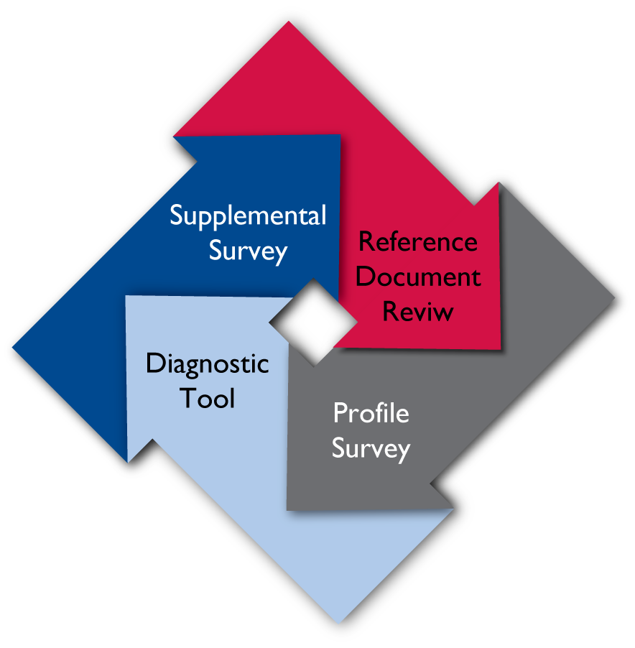
Data Collection Tool
Data collection tool comprises 4 components:
Reference Document Review – background documents and reference materials are collected and reviewed
Supply Chain Profile – a questionnaire designed to create a profile of the supply chain(s) being assessed (one is filled out for each unique supply chain)
Diagnostic Dashboard – evaluation tool used to define the transition stage of each HRH building block
Supplemental Survey (optional) – a survey designed to gather data needed to supplement the Diagnostic Tool data with context and detail where needed

Slide 23
Phase 3 – Collect Data
1
Conduct launch workshop
2
Collect data: conduct interviews and/or focus groups

Slide 24
Phase 3 – Collect Data
Data Collection
Data Analysis
Assessment Team
Informants
Other Relevant Stakeholders
Provide Dimension According to “Definition of Fully Developed”
Analyze Data; Develop Recommendations
Develop Implementation Plan and Report
Discuss Transition Stage for HRH Building Block
Rate Transition Stage of Each HRH Building Block Using Data Collection Tool
Provide “Strengths,” “Opps,” “Improve Areas,” and ”Challenges” of Dimension
Validate Findings and Recommendations
Implement Recommendations

Slide 25
Phase 4 – Analyze Data
1
Analyze data
2
Develop recommendations
3
Validate findings and recommendations
4
Develop implementation plan
5
Report findings and recommendations

Slide 26
Phase 4 – Analyze Data
Data Collection
Data Analysis
Assessment Team
Informants
Other Relevant Stakeholders
Provide Dimension According to “Definition of Fully Developed”
Analyze Data; Develop Recommendations
Develop Implementation Plan and Report
Discuss Transition Stage for HRH Building Block
Rate Transition Stage of Each HRH Building Block Using Data Collection Tool
Provide “Strengths,” “Opps,” “Improve Areas,” and ”Challenges” of Dimension
Validate Findings and Recommendations
Implement Recommendations

Slide 27
Phase 4 – Analyze Data
1
Analyze data
2
Develop recommendations
3
Validate findings and recommendations
4
Develop implementation plan
5
Report findings and recommendations

Slide 28
Session 4 Objectives – Data Collection Tool Introduction
By the end of this session, you will be able to⎯
Confidently use the data collection tool
Define the data collection tool components and purposes

Slide 29
Data Collection Tool
Data collection tool comprises 4 components:
Reference Document Review – background documents and reference materials reviewed to provide context
Supply Chain Profile – a questionnaire designed to create a profile of the supply chain(s) being assessed (one is filled out for each unique supply chain assessed)
Diagnostic Tool – evaluation tool used to define the transition stage of each HRH building block
Supplemental Survey (optional) – a survey designed to gather data needed to supplement the Diagnostic Tool data with context and detail where needed

Slide 30
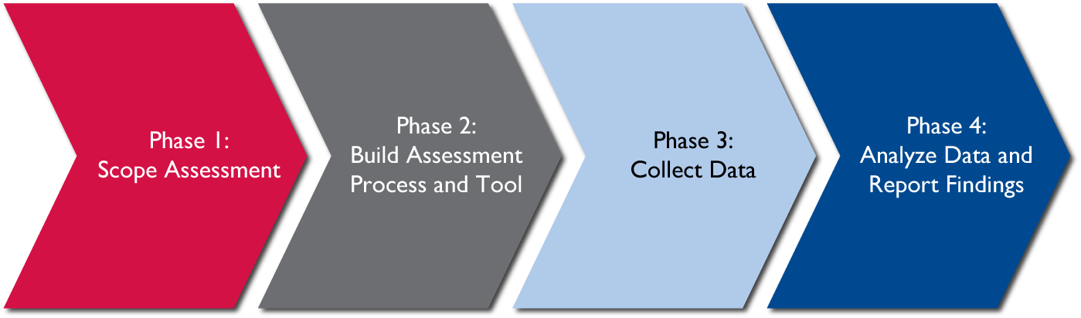
Use the Data Collection Tool
Conduct Reference Document Review and build Supply Chain Profile in order understand the context for the assessment and assessed supply chains
Based on Reference Document Review and Supply Chain Profiles, adapt Diagnostic Tool and select Supplemental Surveys to collect HR data for assessed supply chains
Use Diagnostic Tool and selected Supplemental Surveys to collect HR data for assessed supply chains
Analyze data collected with all data collection tool components to develop findings; based on findings, develop recommendations and a recommendations implementation plan

Slide 31
Use the Diagnostic Tool
HR Dimension for Rating
Baseline Definition of “Fully Developed”
Step 1
Step 2
Step 3
Step 4
HRH Building Block Dimension
Definition of “Fully Developed” Dimension
Sample Questions for Determining Development Stage
Development Stage
Rating
Scale
Questions used to confirm rating
Rated Score –
Based on a 0-4 Scale
Validated Score –
Based on a 0-4 Scale
0 = Does Not Exist
1 = In Development or Outdated
2 = Developed But Not Consistently Applied
3 = Developed and Consistently Applied
4 = Developed and Consistently Applied with Dedicated Budget

Slide 32
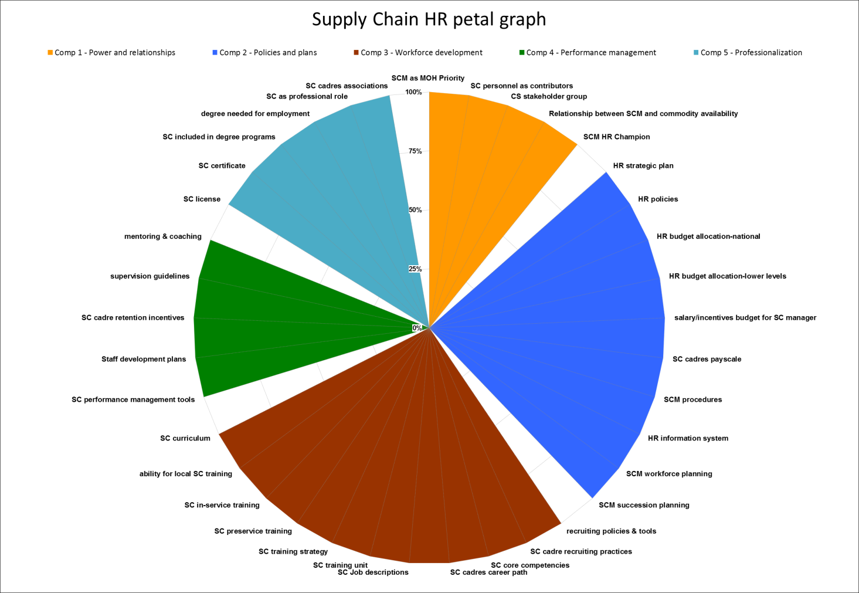
Use the Diagnostic Tool Dashboard
Level 4 (100%):
HR Dimension Is Fully Developed
Colored “Petals:”
HR Components
Level 0:
HR Dimension Does Not Exist
Space Separating Components
If a petal is fully colored in, the HR component is fully developed
HR Dimensions
Sample Display: Fully Developed Supply Chain
Human Resource System

Slide 33
Session 5 Objectives – Data Collection Tool Development
By the end of this session, you will be able to⎯
Develop data collection plan
Modify data collection tool

Slide 34
Activity – Develop Data Collection Plan and Methodology!
Review the Supply Chain Profile
Complete the Data Collection Plan Worksheet
Complete the Data Collection Methodology Worksheet
Be prepared to present your work to the larger group and, ultimately, unify all work into one assessment

Slide 35
Activity – Complete the Data Collection Plan Worksheet!
Supply Chain Assessed: _________________________________
Levels Assessed: _________________________________________
Plan Component | Things to think about… | Organizations… | Informants…
Geographic Area | Size and geographic diversity of country Where supply chain authority lies
Organizations | National/Central Level (Central Medical Stores, Quality Assurance/Drug Authority Offices, Port Authority, Logistics Mgmt Units, Training program/institute offices, Procurement agents or units/department) Intermediate Level (Region, District, etc.) (Regional Distribution Centers or Regional Medical Stores, Health Management Office) Service Delivery Points (Clinics and hospitals, Pharmacies, Labs) Implementing partners Donors Professional Associations Private sector partners

Slide 36
Activity – Complete the Data Collection Methodology!
Organization… | Informant… | Interview, Focus Group or Both? | HR Building Block to Assess

Slide 37
Session 6 – Practice Collecting Data
By the end of this session, you will be able to⎯
Practice skills required to take thorough and accurate notes
Gather HRH building block data using interviewing skills
Gather HRH building block data using focus group facilitation skills

Slide 38
Take Good Notes
Notes
Page
Summary Page
Label Column
Record name of person(s) interviewed, title, organization, and date
Label Column
Record name of person(s) interviewed, title, organization, and date
Number Page
Number Page
Question
Column
Formulate questions based on the notes recorded in “Notetaking Column”
Notetaking
Column
Record: record facts, numbers, ideas, quotes by HRH building block
Reflect: reflect on the material by asking yourself questions, for example: “What’s the significance of these facts? What principle are they based on? How do they impact supply chain functions? How do they fit in with what I already know?”
Summary Column
 | Strength | Area for Improvement | Opportunity | Challenge
Powerful Constituencies
Policies and Plans
Workforce Devmt
Performance Mgmt
Professionalization

Slide 39
Activity – Practice Your Notetaking Skills!
Organize your notetaking paper according to the format you just learned
As you listen to the demonstration interview/- focus group, take notes according to this strategy

Slide 40
Activity – Practice Conducting an Interview!
Find a partner
Pick an HR component to practice with
Use the tool to pick component and sub-component questions to practice with
As you practice, make sure you⎯
Introduce yourself
Explain the purpose of the assessment
Explain how the data will be used
Promise confidentiality
Ask the questions exactly
Record rating/notes
Ask for questions
Thank your informant

Slide 41
Activity – Practice Facilitating a Focus Group!
Form a group of 4 or more
Pick an HR component to practice with
Use the tool to pick component and sub-component questions to practice with
As you practice, make sure you⎯
Introduce yourself
Explain the purpose of the assessment
Explain how the data will be used
Promise confidentiality
Ask the questions exactly
Invite participation
Obtain consensus on the rating score
Record rating/notes
Ask for questions
Thank your respondent

Slide 42
Session 7 – Data Analysis and Reporting
By the end of this session, you will be able to⎯
Analyze HRH building block data and develop recommendations
Develop recommendations implementation plan

Slide 43
Data Analysis Table and Root Cause Analysis
Strengths
Areas for Improvement
Opportunities
Challenges
Strengths are factors with an internal locus that work well and contribute to HRCD of supply chain personnel.
Recommendations should build on the strengths.
Examples include: robust training program or annual performance management process.
Areas for improvement are factors with an internal locus of control that hinder the HRCD of supply chain personnel.
Recommendations should suggest how to improve.
Examples include: decreased salary rate.
Opportunities are conditions with an external locus of control that contribute to the HRCD of supply chain personnel.
These factors can be leveraged when planning interventions.
Examples include: excellent educational program or robust professional association.
Challenges are conditions with an external locus of control that hinder the HRCD of supply chain personnel.
Recommendations should suggest how to overcome.
Examples include: decreasing budget or oppositional cultural beliefs.
HR Building Blocks
Root Cause Analysis
Ask “What is the reason?”
And then for each reason, “Why does that exist?”
Then ask, “How does this impact the assessed supply chain?”
Tip: focus your time on areas with greatest potential impact

Slide 44
Activity – Practice Analyzing Data!
Review sample Dashboard data
Identify “strengths,” “areas for improvements,” “opportunities,” and “challenges”
Identify root causes for internal “strengths” and “areas for improvement” and external “opportunities” and “challenges”
Ask “What is the reason?”
And then for each reason, “Why does that exist?”
Then ask, “How does this impact the assessed supply chain?”
Tip: focus your time on areas with greatest potential impact
Be ready to present analysis for one HRH building block to the group

Slide 45
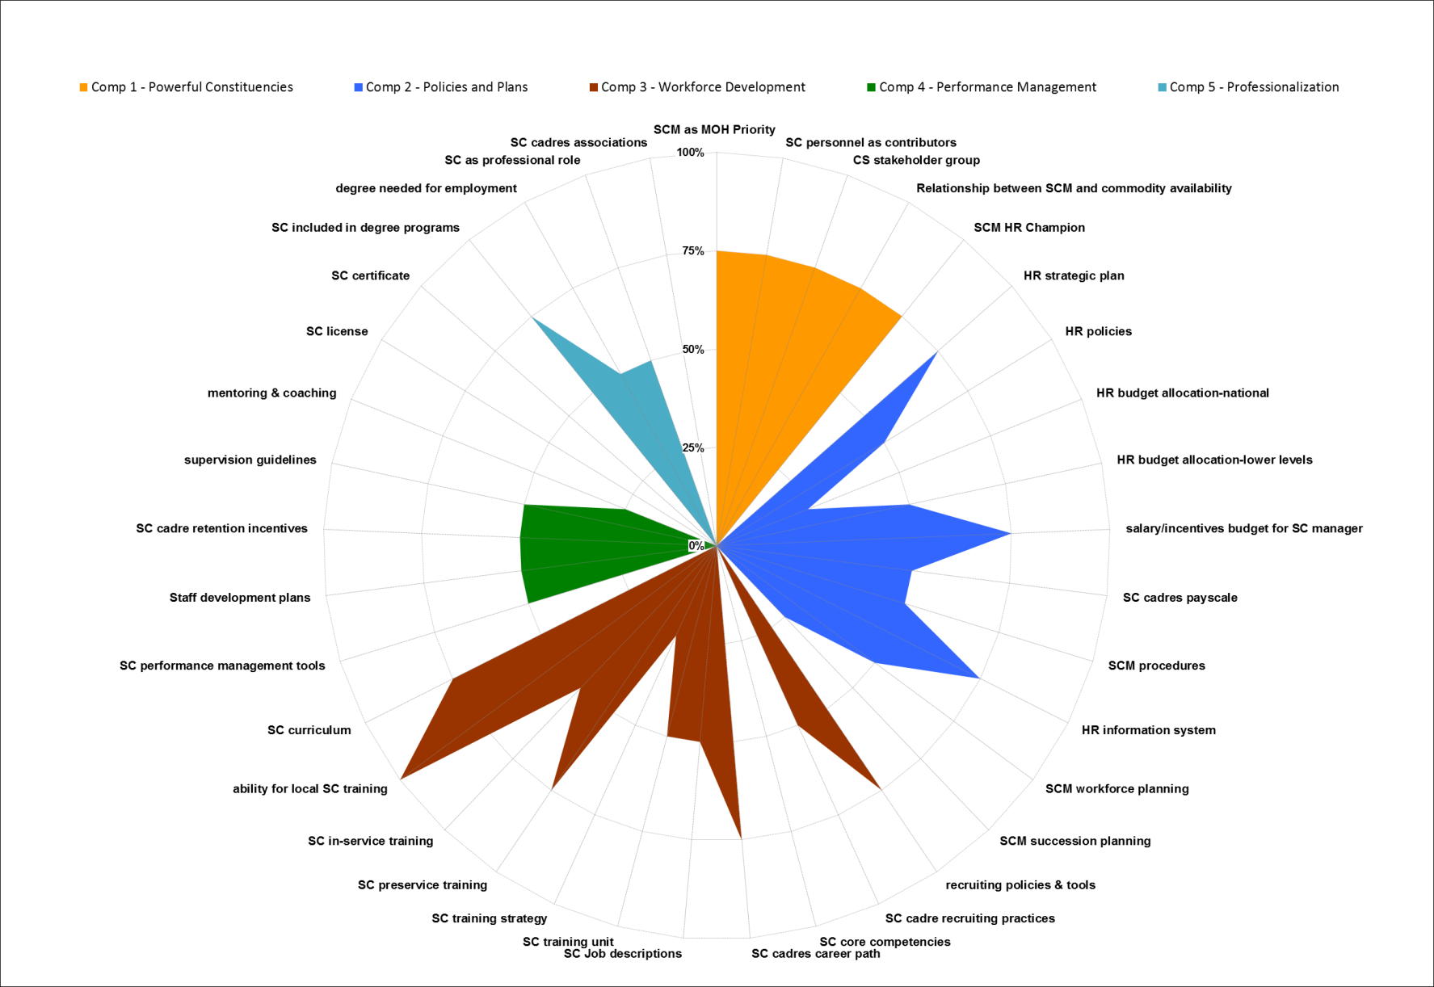
Sample Dashboard with Aggregated Data

Slide 46
Develop Recommendations and Implementation Plan
RECOMMENDATIONS
IMPLEMENTATION PLAN
Respond to analysis and root causes
Link directly to and clearly illustrate impact on a supply chain function
Build long-term human resource capacity for the supply chain
Directly support client objectives and/or country supply chain strategy
Ensure that the solution is manageable and realistic given the resources and skills available, and
Can be achieved within a specified time scale.
Identify steps required to implement solution
Identify timeframe
Identify resources
Identify a person who will be responsible for overseeing the solution.

Slide 47
Activity – Practice Developing Recommendations!
Review the Supply Chain Profile and provided statistics that you will use for this assessment
Identify those causes that, if addressed, might positively impact the supply chain being assessed
Brainstorm recommendations for most impactful causes
Select recommendations for implementation using the criteria provided in the Tool Guide

Slide 48
Activity – Practice Developing an Implementation Plan!
Select one recommendation and develop an implementation plan for that recommendations using this chart
Be ready to present your recommendation and implementation plan to the group
HR COMPONENT: _____________________________
Recommendation | Activities | Person/ Institution Responsible | Involved/ Impacted Partners | Timeframe

